Slide 1



Evaluation in Counseling Supervision: Enhancing Practice through Feedback
Presented by Jennifer Morris, LPC
and Kayla Newkirk, MSED
Notes:
*fix font so it all matches
**send everyone the Microsoft word doc for the case conceptualization note
**https://forms.office.com/Pages/ResponsePage.aspx?id=xELHeRzmpU--iaPLVmqA0VyggJYey2VFi5Mr2I8sX6JUNkc5QTg4TVFDM1JMUjQzVEVWM1RSMVZKWC4u

Slide 2


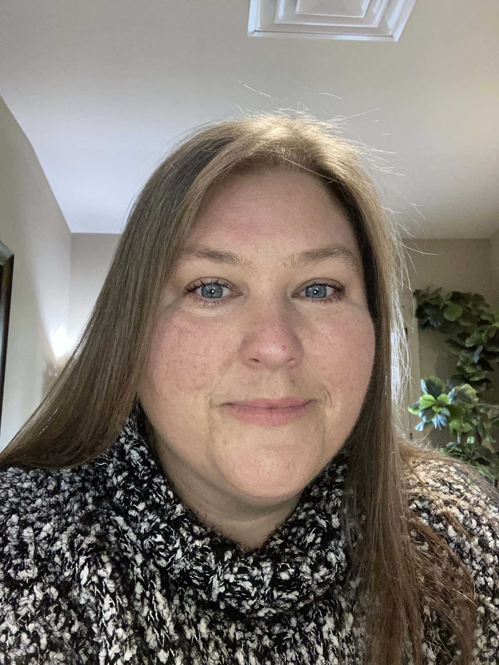
Hello !
I’m Jennifer Morris, LPC

Slide 3
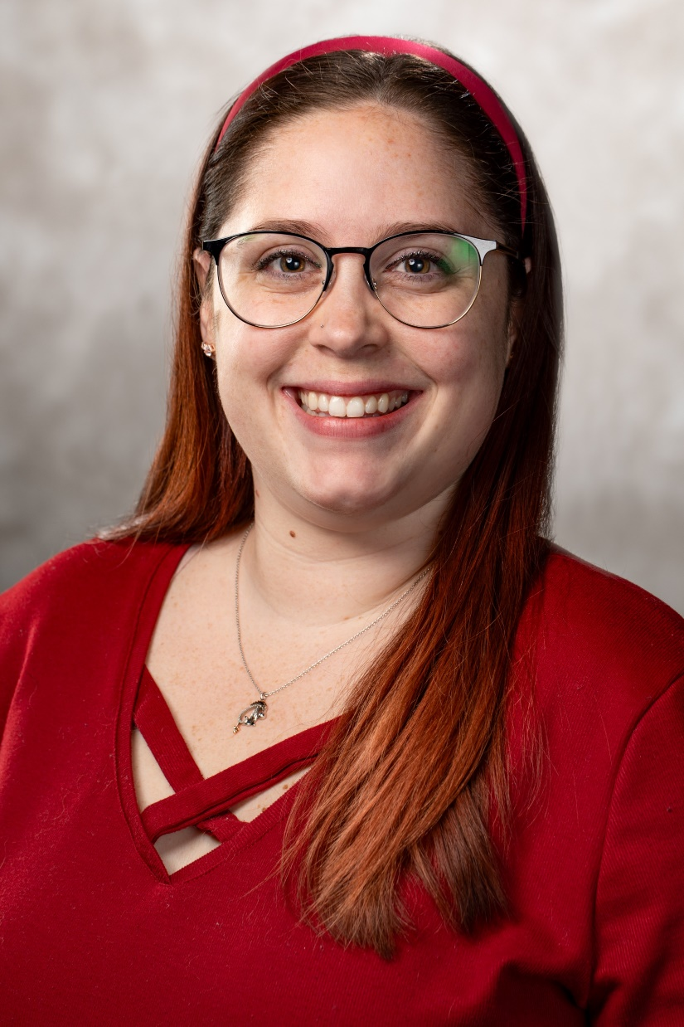
Hello !
I’m Kayla Newkirk, MSED

Slide 4


Objectives of Evaluation in Supervision
Ensure the efficacy and safety of counseling practices.
2. Support supervisee growth and professional development.
3. Maintain ethical standards in counseling
Next
Notes:
Being an evaluator can sometimes feel contrary to who we are as therapists.
*include primary section of standards of where they are for supervision in ACA* ACA code this from dr Popejoy if you haven’t ever reviewed them, they’re there. Our supervisees need to maintain sections a and b, but we also have to maintain in the other sections as well. *
**Code of Ethics = F6 and F6A speaks to evaluative piece

Slide 5
Objectives of Evaluation in Supervision
Ensure the efficacy and safety of counseling practices.
2. Support supervisee growth and professional development.
3. Maintain ethical standards in counseling
Next
Notes:
Being an evaluator can sometimes feel contrary to who we are as therapists.
*include primary section of standards of where they are for supervision in ACA* ACA code this from dr Popejoy if you haven’t ever reviewed them, they’re there. Our supervisees need to maintain sections a and b, but we also have to maintain in the other sections as well. *
**Code of Ethics = F6 and F6A speaks to evaluative piece

Slide 6
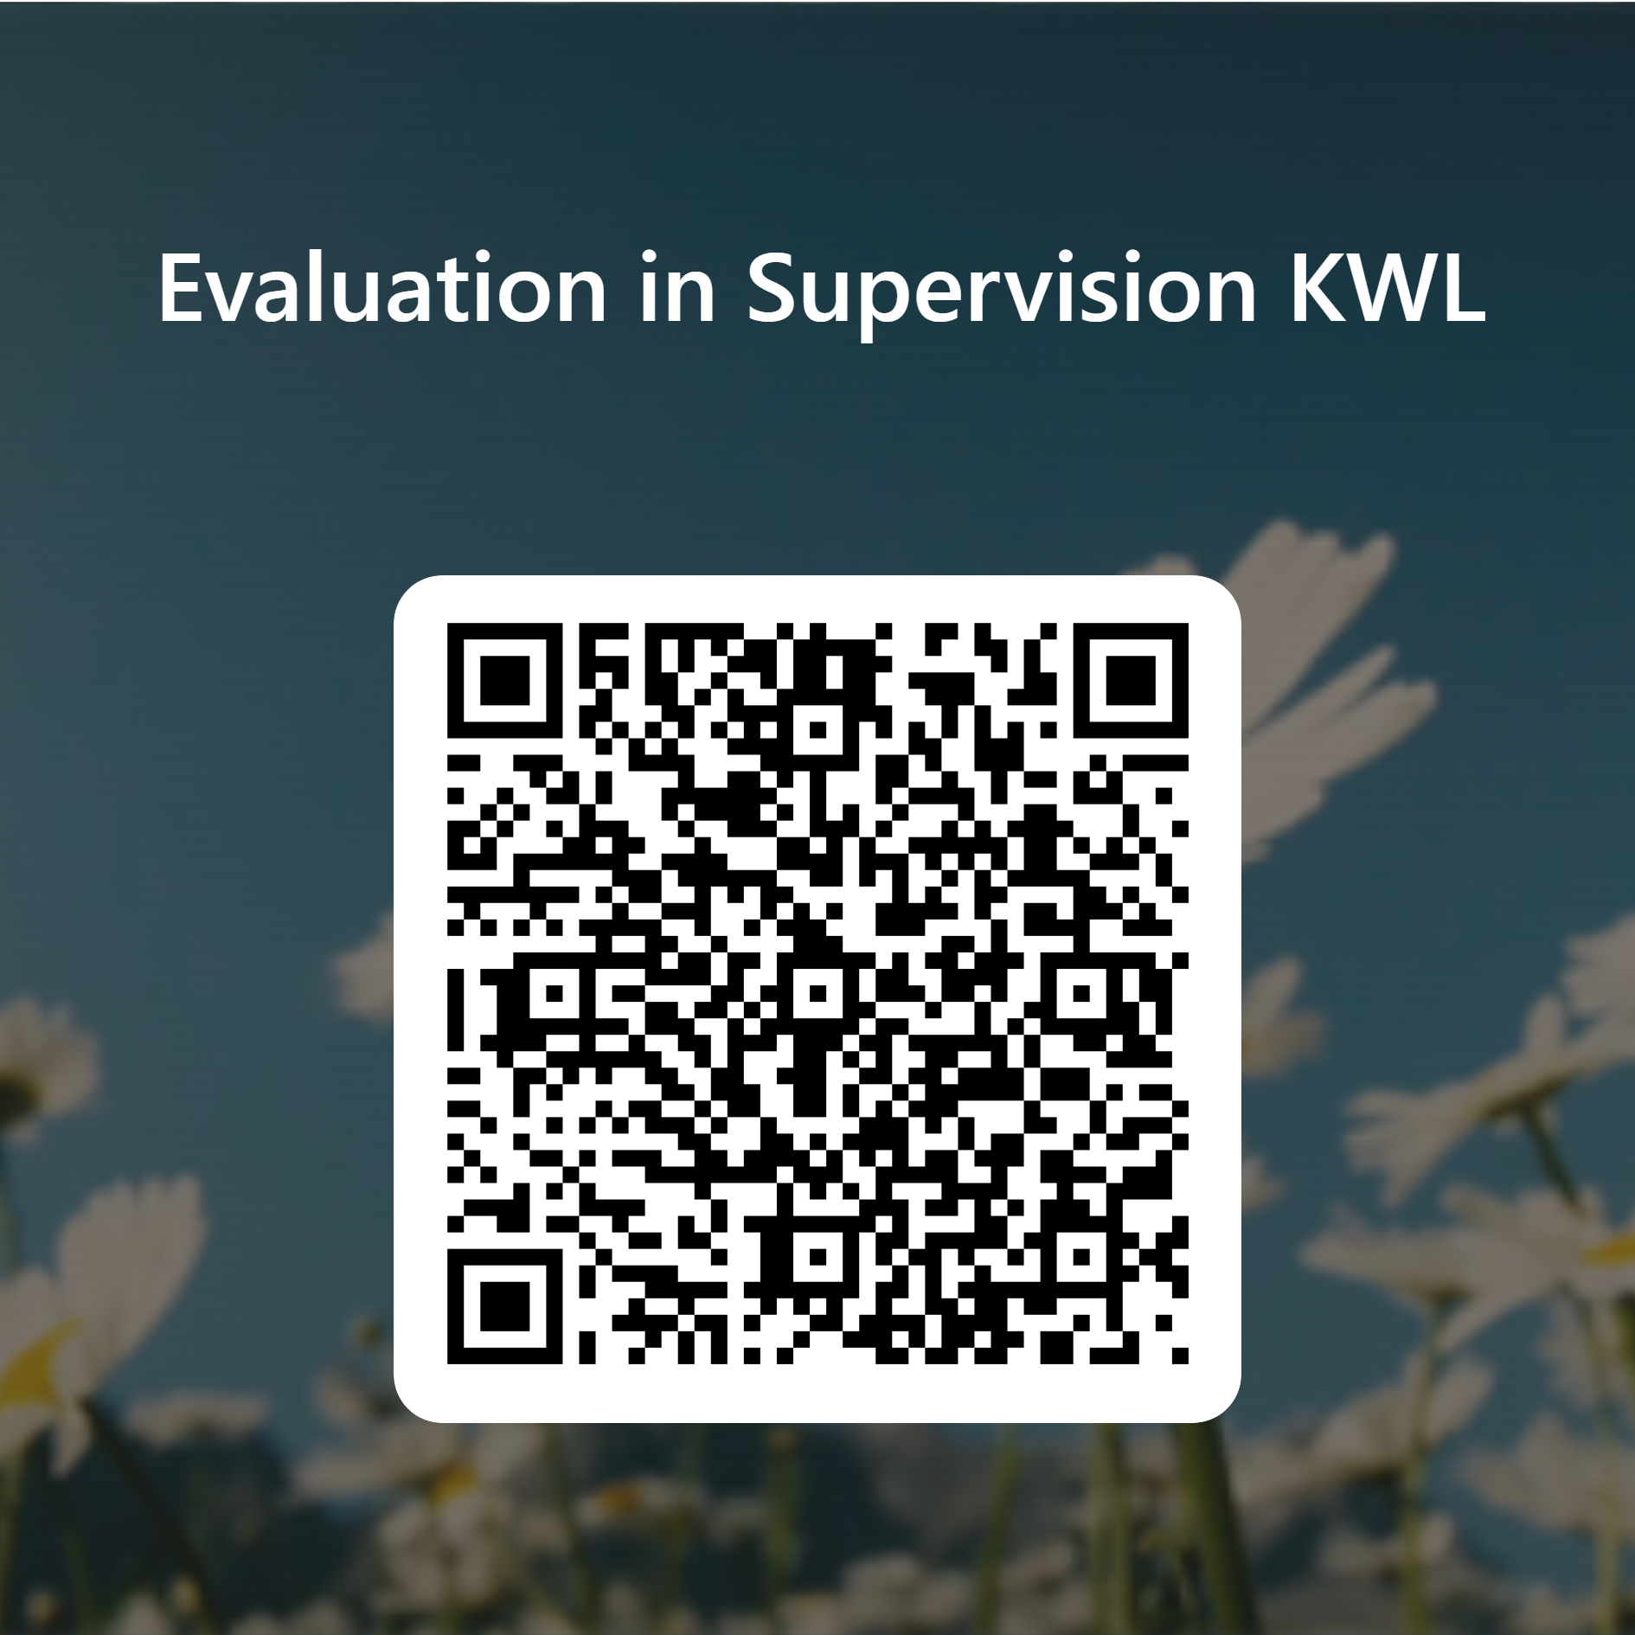
KWL
Next
Notes:
Please answer the first two questions: what do you already know and what do you want to know
https://forms.office.com/Pages/ResponsePage.aspx?id=xELHeRzmpU--iaPLVmqA0VyggJYey2VFi5Mr2I8sX6JUNkc5QTg4TVFDM1JMUjQzVEVWM1RSMVZKWC4u

Slide 7
Common Evaluation Challenges
Balancing Support and Assessment
Maintaining Objectivity
Dealing with Defensive Reactions
Competency Evaluation
Cultural Humility
Next
Notes:
1. Discuss different hats we wear (e.g. counselor, teacher, consultant, and overall supervisor and evaluator)
3. Anytime we can get our supervisees to a place of self-awareness and balanced self-evaluation it is a win and makes our job easier. It will also decrease defensive reactions
4. This is one of the reasons you are here

Slide 8
Common Evaluation Challenges
6. Time Constraints
7. Ethical Dilemmas
8. Lack of Training
9. Documentation and Follow-up
10. Technology Use
Next

Slide 9
3 Tools to Help Improve Feedback
Case Conceptualization Worksheet
Role Play
Journaling
Next
Notes:
**

Slide 10
Case Conceptualization in Counseling Supervision
Enhancing Understanding
Theory Practice
Skill Development
Purpose of Case Conceptualization:
Next

Slide 11
Case Conceptualization in Counseling Supervision
Client initials and demographics | Presenting Concern(why are they in therapy)/ and their Risk | Conceptualization using theory – What are you seeing is their need. | What is your plan or your goals with the client | Social/Cultural Factors – any special factors relevant to the client.
A.B., 8-year-old Caucasian male | Mom reports difficulty focusing in school, disruptive in class Risk of academic underperformance - Social isolation | - REBT can be applied to understand A.B.'s disruptive behaviors as potentially stemming from irrational beliefs about needing to always be entertained or noticed His inability to focus might be related to beliefs that tasks should always be easy or enjoyable (school can be difficult and lead to frustration) | Help A.B. identify and challenge these irrational beliefs, replacing them with more rational alternatives. 2. Use techniques to practice new skills in focus and self-control. **Parental involvement in reinforcing these concepts at home would be crucial | High parental expectations and pressure may contribute to stress. - Possible cultural stigma around mental health intervention requires sensitive handling.
C.D., 15-year-old African American female | Reports feeling overwhelming sadness, withdrawal from friends and family, declining grades. - Risk of depression and potential self-harm. | In Gestalt therapy, C.D.'s feelings of sadness and isolation might be viewed as interruptions in her natural growth and self-fulfillment process. Her symptoms could be stemming from unfinished business or unresolved past conflicts that are affecting her present awareness. | Focus on increasing awareness of her current feelings and experiences in the 'here and now’. 2. Use techniques such as the empty chair to facilitate dialogue with aspects of herself or with figures from her past that she has unresolved issues with. | - Challenging familial dynamics, socio-economic status, and lack of feeling supported
E.F., 35-year-old Hispanic male | Reports experiencing panic attacks and severe anxiety, impacting work performance and personal relationships for 3 months Risk of job loss Reports ‘deteriorating’ relationship with his partner | - From a cognitive-behavioral perspective, anxiety might be linked to distorted thinking patterns and excessive worry about future events, possibly reinforced by past experiences | Develop coping strategies for anxiety and panic attacks through cognitive restructuring and exposure therapy. Enhance resilience and stress management techniques. **Career counseling may be beneficial to address work-related stress. | Cultural beliefs about masculinity may inhibit seeking help or expressing vulnerabilities Family role expectations might also exacerbate stress and anxiety
Next
Notes:
Is there anything that stands out to you as a supervisor? What feedback would you want to give your supervisee based on these case conceptualizations?
What do you think this supervisee did well when filling this out? Using theory went well. And seeing some presenting concerns to focus on for goal planning.
What growth edges do they have? Cultural considerations. With goal planning, needing more details with how to gain parental involvement and how they could implement career counseling.
**make sure they are using the same theory for every client**
*Helps with theoretical development and knowledge and their ability to diagnose correctly (using assessments to accurately follow up with self or parent reports)

Slide 12
Role Playing in Counseling Supervision
Purpose of Role Playing:
Practice and refine specific techniques and skills
Empathy and Perspective Taking
Feedback and Adjustment
Next
Notes:
It is a supportive environment to develop their skills
They can experience their client's perspective or understand different client situations. It will enhance their empathy and interpersonal effectiveness
Immediate feedback allows quick adjustments and learning
*can you create rapport with somebody? Demonstrating empathy. Specific skill building ex: working with resistant client. You’re moving from just reflecting feeling to other skills. All depends on supervisee and what you see. Challenge them to do a roleplay for ten minutes and reflect content and feeling. Do not ask questions or limit to two questions and they are open ended questions.

Slide 13
How to Use Role Play in Supervision
Set Up Role Play
  Define objectives
  Build Scenario
  Assign Roles and Guidelines
Conducting Role Play
  Warm-up
  Execution
  Use of Props and Setting
Debriefing and Feedback
4. Repetition and Variation
5. Ethical Considerations and emotional safety
Next
Notes:
Clearly define what skills or competencies the play is designed to develop
Build a scenario relevant to the supervisee's current or expected case load
Guidelines should be provided about how the "client" should act, including specific bx and emotions
The warm-up can help people transition into their roles
Provide immediate feedback and discuss both what was done well and what could be improved
Allow supervisee to repeat same scenario in order to improve skills after feedback
Variations help the supervisee cover a wide range of situations and client types
Choose scenarios that are sensitive to the backgrounds and experiences of supervisees to avoid triggering undue distress.
Est safe and respectful environment: Keep feedback balanced

Slide 14
Role Playing in Supervision Scenario
Objectives:
Effectively address and manage resistance
Re-engage the client in therapy
Explore underlying issues contributing to the clients bx
Next
Notes:
Being an evaluator can sometimes feel contrary to who we are as therapists.
*let ppl know bx = behavior

Slide 15
Role Playing in Supervision Scenario
Role Play Setup:
Supervisor: Jamie: acting out the resistance realistically based on common bx seen in therapy
Environment: Set up the room to mimic a typical therapy setting to make the role play feel as realistic as possible
Next
Notes:
Being an evaluator can sometimes feel contrary to who we are as therapists.

Slide 16
Role Playing in Supervision Scenario
Jamie, a 30-year-old client, has been coming to therapy for six months to address anxiety and relationship issues. Recently, Jamie has shown signs of resistance: being late to sessions, minimal engagement, and avoiding deep discussions about challenging topics.
The Supervisee is tasked with engaging Jamie, addressing the resistance, and encouraging more active participation in therapy.
Next
Notes:
Being an evaluator can sometimes feel contrary to who we are as therapists.

Slide 17
Role Playing in Supervision Scenario
Steps for Supervisee:
Recognize and Acknowledge Resistance
Explore Underlying Issues
Reflective Listening
Address Therapy Goals
Collaborative Problem Solving
Enhance Motivation
Next
Notes:
Being an evaluator can sometimes feel contrary to who we are as therapists.

Slide 18
Role Playing in Supervision Scenario
Debriefing Questions:
What Strategies did you find most effective in addressing the resistance?
How did you feel during the interaction? Were there moments you felt stuck?
What could have been done differently to engage the client more effectively?
How did the role of Jamie respond to different interventions?
What did you learn from this role play about managing resistance in therapy?
Next
Notes:
Being an evaluator can sometimes feel contrary to who we are as therapists.

Slide 19
Role Playing in Supervision Scenario
Provide Feedback and Repeat Scenario allowing supervisee to practice using their new insights and feedback
Next
Notes:
Being an evaluator can sometimes feel contrary to who we are as therapists.

Slide 20
Journaling in Counseling Supervision
The purpose of Journaling
Next
Notes:
Journaling is an elective tool. The supervisor can offer it to the supervisee as a way to expand their training experience and enhance what they get out of it. It works best if the supervisee uses it regularly and adapts it to fit their personal style and professional needs. Ethical considerations: Remind them not to put client identifying information in their journal. It is not a clinical note.
*be aware of journaling about some of this stuff requires a certain level of self-awareness. This may not be for everyone, particularly in practicum. Use clinical judgment to ensure that you are giving this to supervisees who are able to use this effectively.
*Can say put that in the case conceptualization note if they do not need a full journal.

Slide 21
Journaling in Counseling Supervision
Reflective Practice
  Successes
  Areas of improvement
  Emotional Responses
Skill Development
  Articulate techniques
  Deeper consideration of client responses
Next
Notes:
Journaling is an elective tool. The supervisor can offer it to the supervisee as a way to expand their training experience and enhance what they get out of it. It works best if the supervisee uses it regularly and adapts it to fit their personal style and professional needs. Ethical considerations: Remind them not to put client identifying information in their journal. It is not a clinical note.

Slide 22
Using the Journal in Supervision
Guided Prompts
  Client dynamics
  Emotional reactions
  Ethical Dilemmas
  Application of specific techniques
Selective Sharing
Starting point for discussion and feedback
Integration with Supervision Goals
Next
Notes:
You can potentially give your supervisee a journal. 2. Supervisee gets to choose what they share 3. Guide the supervisee in setting developmental goals 4. Ensure that journaling supports the supervisee's overall developmental trajectory.

Slide 23
What feelings came up for you when the client responded to your session?
During today’s session, when the client finally opened up about their recent loss, I felt a mix of relief and anxiety. Relief, because it felt like a breakthrough after several sessions of surface-level discussions, but anxiety because I sensed the depth of their grief and felt momentarily unsure about how best to support them. This moment made me question my readiness to handle such intense emotions. However, recognizing the client's trust in sharing such a personal experience also instilled a sense of responsibility in me to further hone my skills in grief counseling.
Next
Notes:
You can potentially give your supervisee a journal. 2. Supervisee gets to choose what they share 3. Guide the supervisee in setting developmental goals 4. Ensure that journaling supports the supervisee's overall developmental trajectory.

Slide 24
What would you have liked to have done differently in this session?
There were a few moments where the client appeared contemplative, possibly ready to delve deeper into their feelings about their family dynamics. Instead of allowing those silent moments to serve as a therapeutic tool, I hurried to fill them with questions or reaffirmations. I wish I had allowed those pauses to extend a bit longer, giving the client more space to process their thoughts or articulate deeper feelings. This reflection makes me realize the importance of being comfortable with silence as a facilitator of client self-exploration.
Next
Notes:
You can potentially give your supervisee a journal. 2. Supervisee gets to choose what they share 3. Guide the supervisee in setting developmental goals 4. Ensure that journaling supports the supervisee's overall developmental trajectory.

Slide 25
What do you think went well in this session? How do you feel about it now?
In today's session, I implemented a new technique we discussed last week in supervision—using metaphors to help clients articulate their experiences of anxiety. I was initially skeptical about how well it would resonate with the client, but the metaphor of "carrying an invisible backpack that gets heavier throughout the day" seemed to really connect with them. They were able to express how their anxiety builds and impacts them daily. Seeing this technique work effectively boosted my confidence significantly. It reinforced the value of integrating creative approaches into therapy, and I feel encouraged and eager to continue exploring and applying these methods.
Next
Notes:
You can potentially give your supervisee a journal. 2. Supervisee gets to choose what they share 3. Guide the supervisee in setting developmental goals 4. Ensure that journaling supports the supervisee's overall developmental trajectory.

Slide 26
Objectives of Evaluation in Supervision
Ensure the efficacy and safety of counseling practices.
2. Support supervisee growth and professional development.
3. Maintain ethical standards in counseling
Next
Notes:
Being an evaluator can sometimes feel contrary to who we are as therapists.

Slide 27

Notes:
Answer the last question ☺
https://forms.office.com/Pages/ResponsePage.aspx?id=xELHeRzmpU--iaPLVmqA0VyggJYey2VFi5Mr2I8sX6JUNkc5QTg4TVFDM1JMUjQzVEVWM1RSMVZKWC4u

Slide 28
Any
Questions?

Slide 29
Thank
You!
Jennifer Morris, LPC: jgrim@uark.edu
Kayla Newkirk: knewkirk@uark.edu

